Slide 1

Predicting the Chance of Admission
CSUF
ISDS 540
By:
Johnny Zhang,
Janelle Gollaba,
Sandeep Prasad,
Manuel Andrade,
Aditi agrawal
Notes:
Good afternoon. We are (introduce yourselfs) and today we will present our linear regression model. Specifically, we are attempting to make a prediction on the chance of admsiossn a given applicant has of being accepted.

Slide 2

Question of Interest:
How is a Student's Chance of Admission affected by the following variables?
GREScore - Graduate Record Examinations Scores
TOEFLScore - Test Of English as a Foreign Language
UniversityRating - rating based on a scale of 1-5
SOP - strength of the statement of purpose based on a scale of 1-5
LOR - strength of the letter of recommendation based on a scale of 1-5
CGPA - the applicants undergraduate GPA.
Research - student's research experience (0 = do not have and 1 = have)
Notes:
GRE: a standardized test that is an admissions requirement for many graduate schools
TOEFL Scores: standardized test to measure the English language ability of non-native speakers wishing to enroll in English-speaking universities.
University Rating: the overall university rating based on a scale of 1-5.
Statement of Purpose and Letter of Recommendation Strength: the rating of the strength of the letter of recommendation for the applicant.
Undergraduate GPA: the applicants overall GPA.
Research Experience ( either 0 or 1 ): whether the student has research experience or not. 0 = no and 1 = yes
Chance of Admit (dependent variable): the chance of a student getting admitted to a university.
Aside from this, Chance of Admit is the dependent variable and the rest are independent variables.

Slide 3
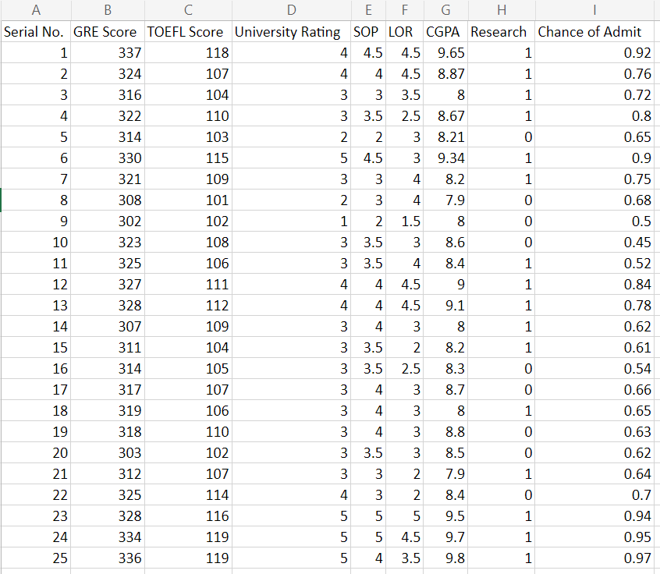
Descriptive Statistics
Our Raw Data contains 500 rows and 9 columns which includes
the dependent variable (ChanceOfAdmit),
7 independent variables, and a Serial No. column which has been removed.
This data set is owned by Mohan S Acharya and obtained from:
https://www.kaggle.com/mohansacharya/graduate-admissions
With test scores and GPA are in the older format and from an international student perspective
Notes:
Now briefly present some descriptive statistics on our data set.
Automatically, the variable Serial No. is removed. This is because it is only a serial number of the applicant. Thus, irrelevant in making a prediction.
Aside from this, we initially considered the variables listed above.
However, before doing so please note that University Rating, Research, and SOP are by default considered categorical. This is because University Rating and Research may only take whole numbers between 1-5 and 0 or 1 for Research. Likewise, SOP may take, beginning from 0.5, increments of 0.5 up to 5.
The rest of the variables are continuous.

Slide 4
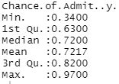
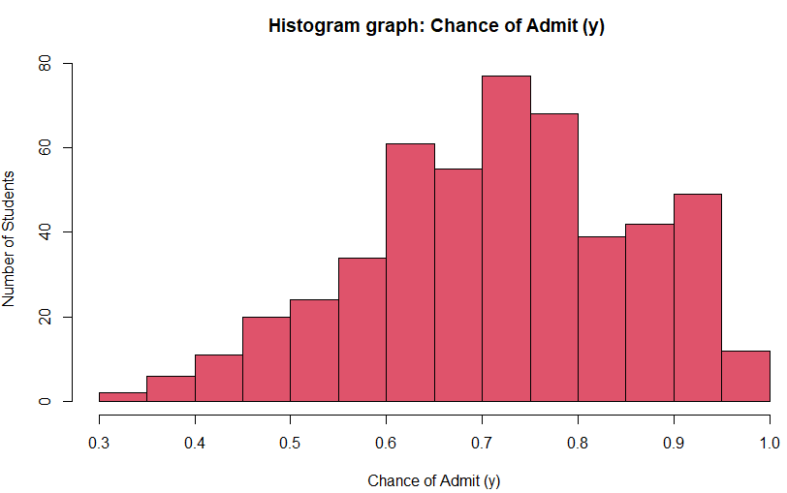
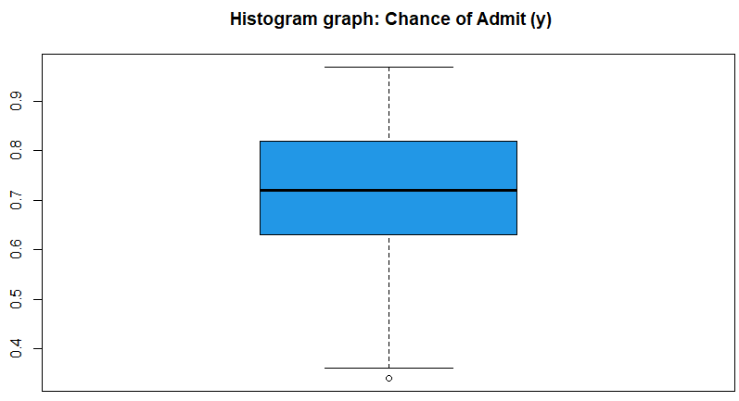
Chance of Admission (y)
Min: 0.3400
1st Qu.: 0.6300
Median: 0.7217
3rd Qu: 0.8200
Max: 0.9700
IQR: 0.1900
STD: 0.1411
Notes:
First, chance of admission is slightly skewed to the right and has an IQR of 0.19 and a standard deviation of 0.1411. This indicates that there is slight variability.

Slide 5
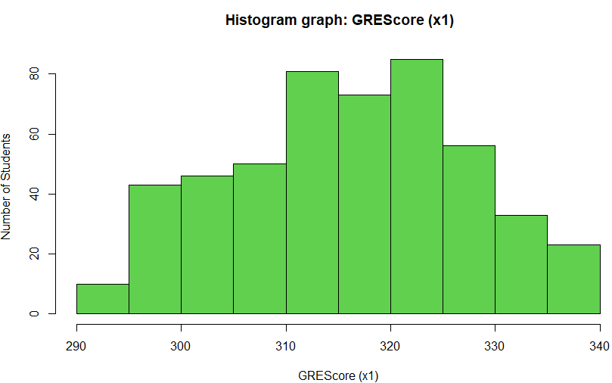
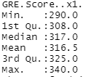
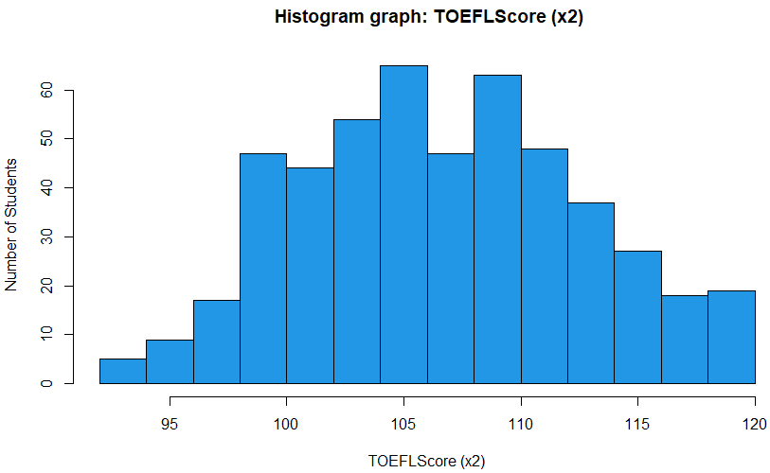
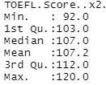
GRE Score and TOEFL Score
GRE
TOEFL
Notes:
Next it is noted that the GRE and TOEFL scores are somewhat normally distributed with GRE being slightly skewed to the left and TOEFL being slightly skewed to the right.

Slide 6
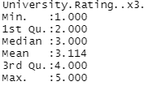
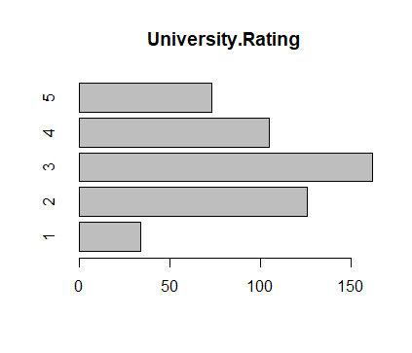

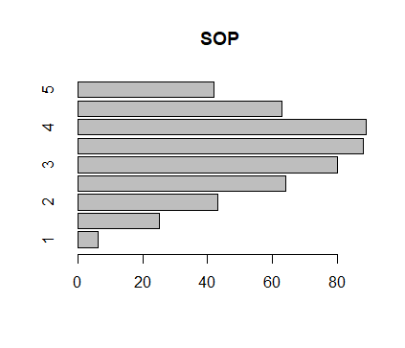
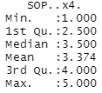

University Rating and SOP
Notes:
Next it is noted that there are only 34 observations of 1 for University Rating. Likewise, there are only 5 observations of 1 for SOP.
This will become critical later on in our analysis.

Slide 7
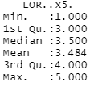
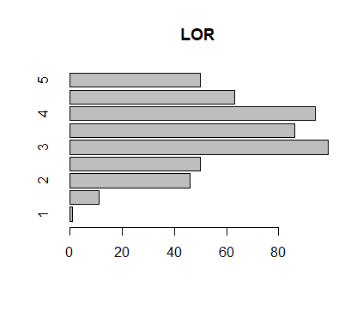
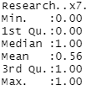
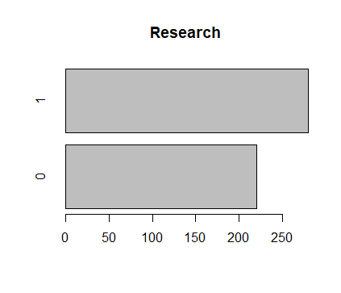
LOR and Research
Notes:
Likewise, LOR has there is only 1 observation for rating 1 and only 11 observations for rating 1.5.
Aside from this, the dummy variables for research are even in comparison to the other categorical variables.

Slide 8
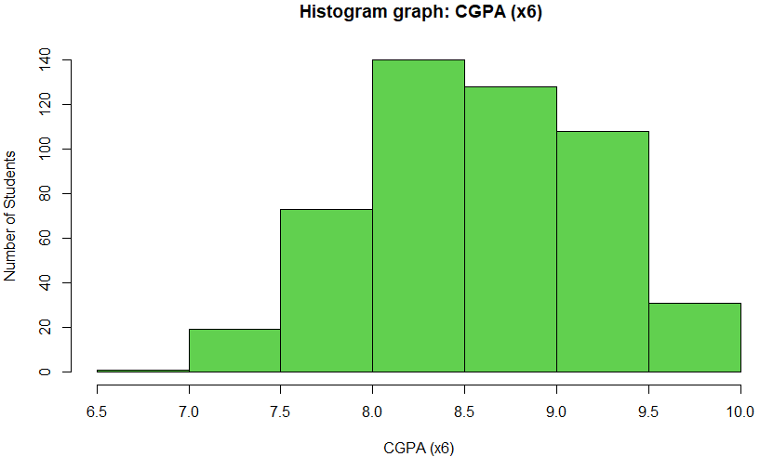
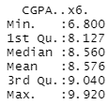
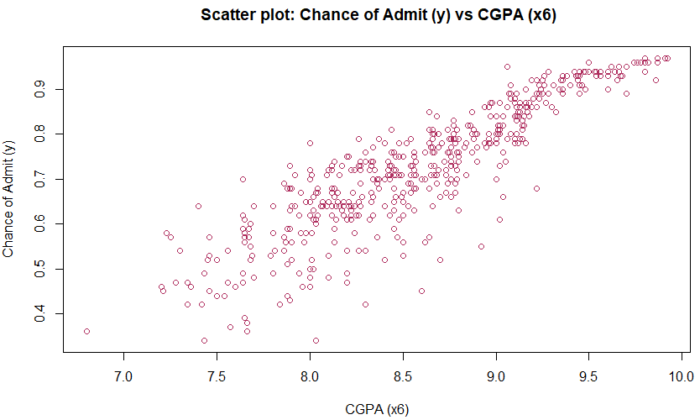
Undergraduate GPA (x6)
Notes:
Lastly, here we see that the variable GPA is skewed slightly to the right.

Slide 9
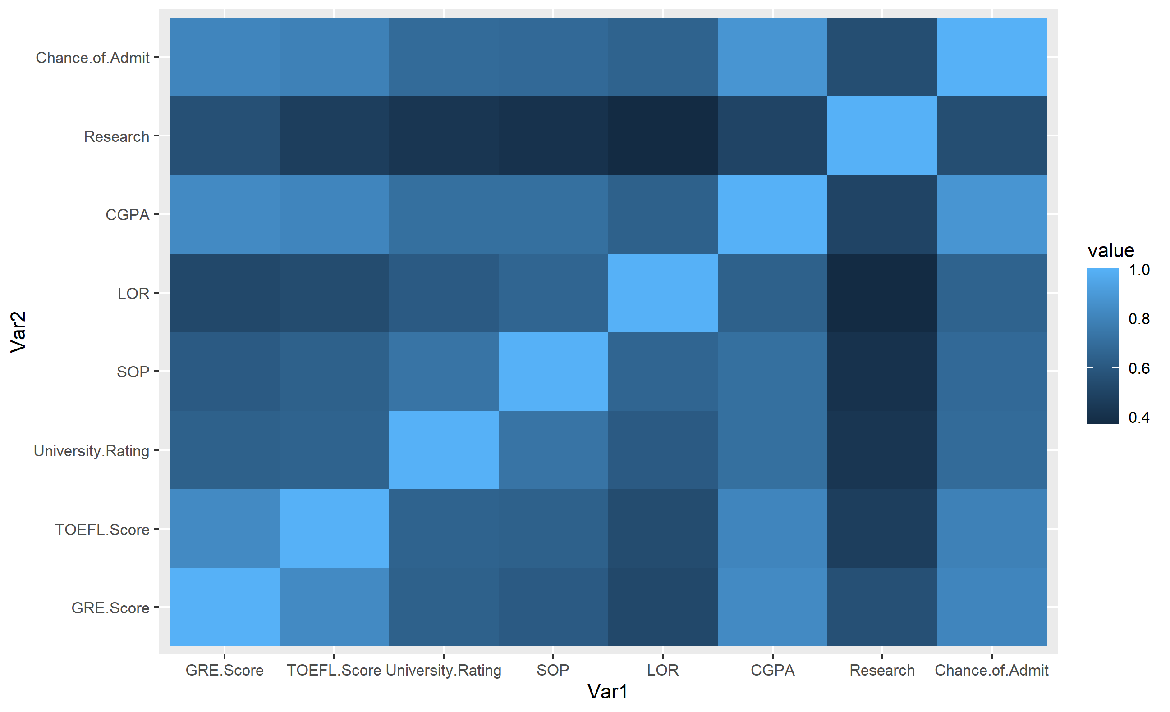
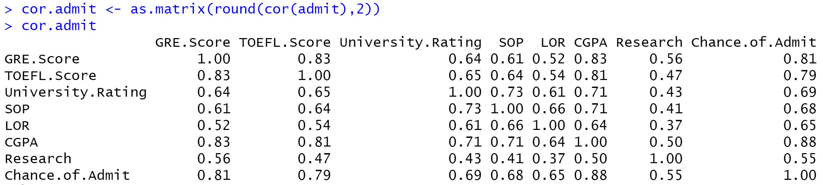
Correlations
Notes:
Next, when it comes to correlations it is noted that there are high correlations between GREScore and ChanceOfAdmit, CGPA and ChanceOfAdmit, and TOEFLScore and ChanceOfAdmit. This leads us to looking to at the scatter plot matrix.

Slide 10
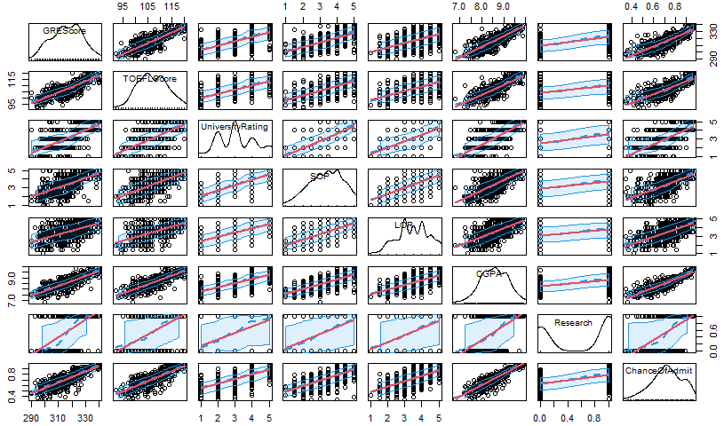
Scatter-plot Matrix
Notes:
When briefly looking at the scatter plot matrix we may see that the majority of the variables are linear. Thus, to see if there is a linear relationship between the independent variables and dependent variables. If there is one, we wish to know which variables are significant.

Slide 11
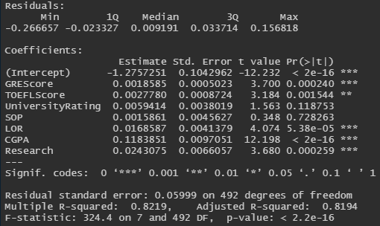
Continuous vs Categorical
Adjusted R-square = 81.94%​
Significant variables:
GREScore
TOEFLScore
LOR
CGPA
Research
Notes:
First, we decided to run the model with all the independent variables as continuous to see the results. Surprisingly, although there are variables that may be considered categorical, the output was pleasing. Specifically, the adjusted r square was 81.94%. This indicates that 81.94% of the variation is explained by the model. Moreover, we may note that the significant variables are GREScore, TOEFLScore, LOR, CGPA, and Research. This is because the pvalue is less than alpha and alpha has a default value of 0.05. Thus, when conducting a hypothesis test, we would end up rejecting the null hypothesis and accept the alternative for the majority of the variables. This means that there is a linear relationship between the dependent variable and each independent variable.
A similar conclusion is reached when conducting hypothesis testing using the CV approach.

Slide 12
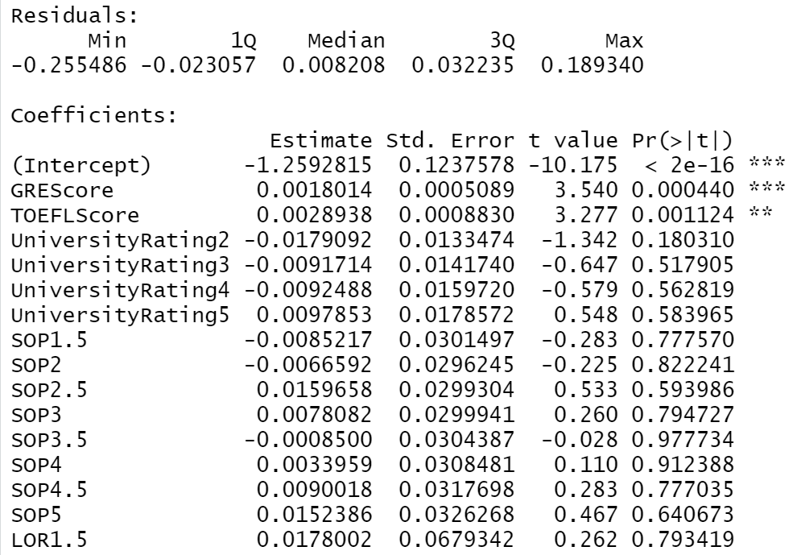
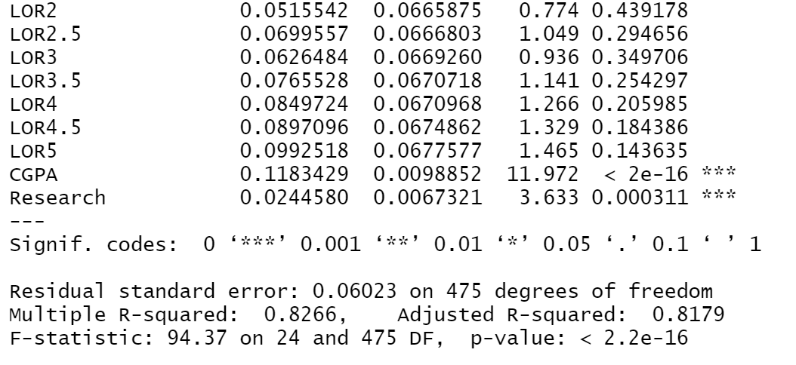
Continuous vs Categorical
Adjusted R-square = 81.79%​
Significant variables:
GREScore
TOEFLScore
CGPA
Research
LOR
Notes:
Aside from this, we ran the model with some categorical and continuous variables. Again, the categorical variables by default are University Rating, Research, and SOP.
The result was an Adjusted R-square of 81.79%, which is slightly lower than the adjusted r square compared to previous model. Also, the majority of the categorical values were rendered insignificant since they had a high p-value. A possible explanation for this is that there are few observations for specific values of the categories. For instance, it was previously noted that for university rating there is only 1 observation for a rating of 1.
Nonehteless, we must now look at the RMSE.

Slide 13
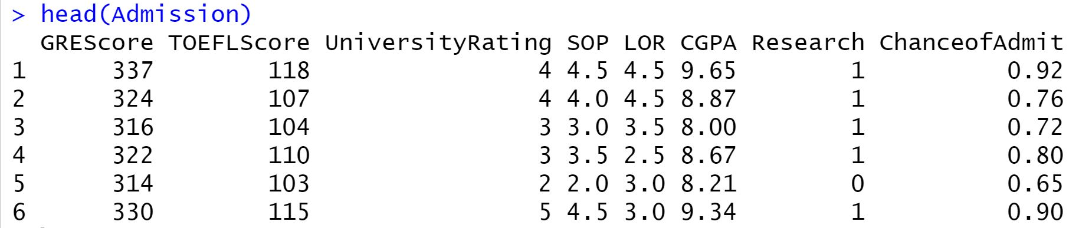
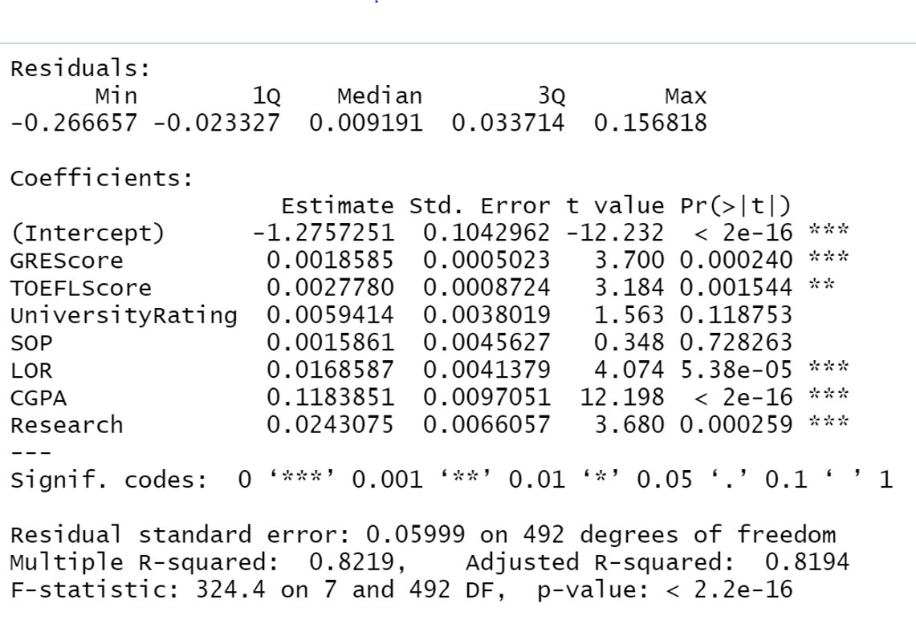
Evidence and Methods
Multiple Regression
- to model the linear relationship between the explanatory or independent variables (GRE, TOEFL, University Rating, SOP, LOR, CGPA, Research) and the response variable (Chance of admittance)
Initial Results:
Adjusted R-square = 81.94%
Significant variables: GRE, TOEFL, *LOR, CGPA, Research

Slide 14
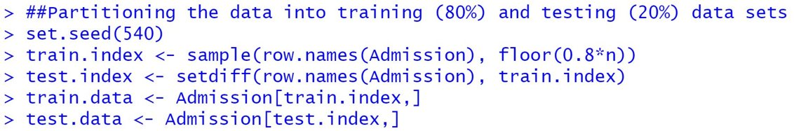
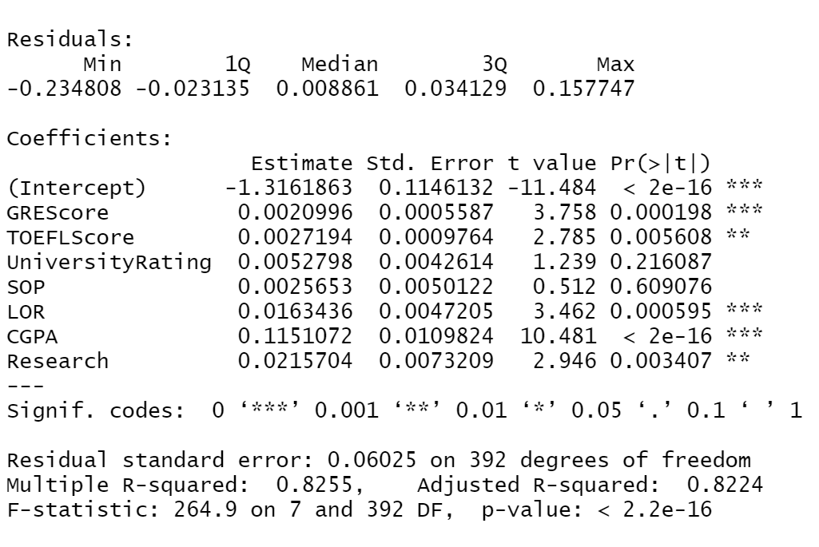
Continuous Model 1
Including all predictors as continuous on training data set
MSE1 = 0.003496
RMSE1 = 0.05912
Notes:
Before, going into more depth, we must state that we used an 80/20 split for training and testing our model.
First, the RMSE for Model 1, which includes all predictors as continuous, has an MSE of 0.0035 and an RMSE of 0.05912. This means that it fits relatively will.

Slide 15
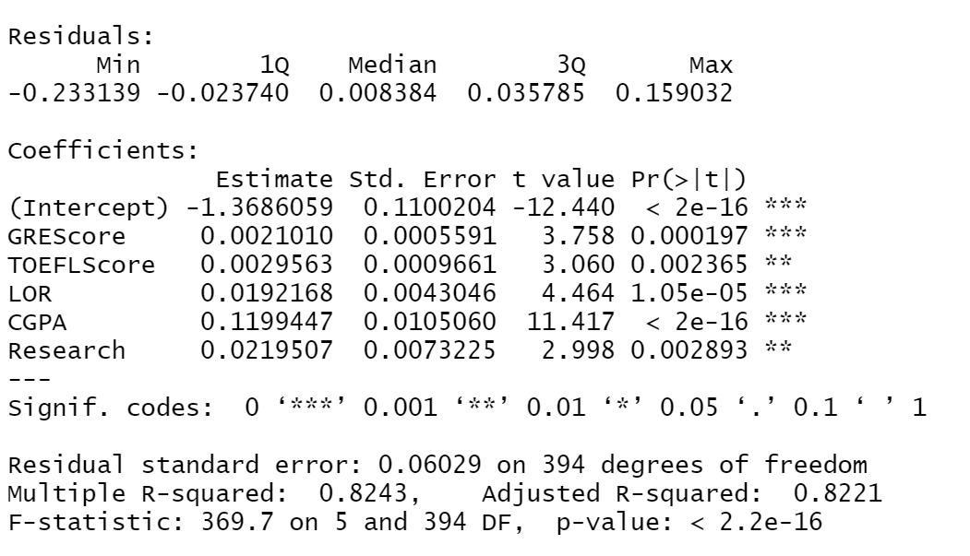
Continuous Model 2
Removing insignificant predictors (UniversityRating, SOP) to improve the model
MSE2 = 0.003523
RMSE2 = 0.05935
*MSE & RMSE almost the same as model 1
Notes:
Next, we decided to remove all the insignificant predictors and it rendered and MSE of 0.0035. However, it slightly increased the RMSE to 0.05935.

Slide 16
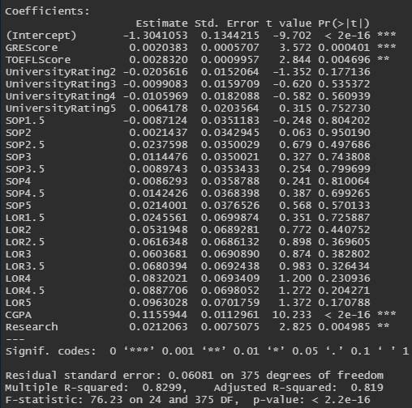
Categorical Model 3
Removing insignificant predictors (UniversityRating, SOP) to improve the model
MSE3 = 0.003480052
RMSE3 = 0.05899196
Notes:
Aside from this, we ran model 3 with the categorical variables previously stated. This yielded an MSE of 0.0035 and an RMSE of 0.05899. However, looking at our counts we see attempted to get better results by removing variables that have poor observations like LOR and SOP.

Slide 17
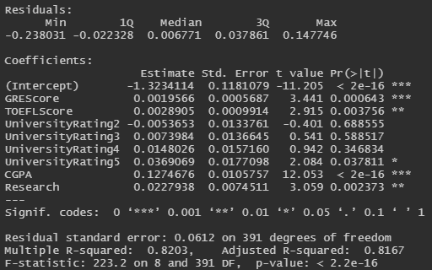
Categorical Model 4
Removing LOR and SOP
MSE3 = 0.003643128
RMSE3 = 0.06035833
Notes:
When we ran model 4 we expected a better RMSE. However, the rmse turned out to be worse. By contrast, we did note the Adjusted R Square did improve.

Slide 18
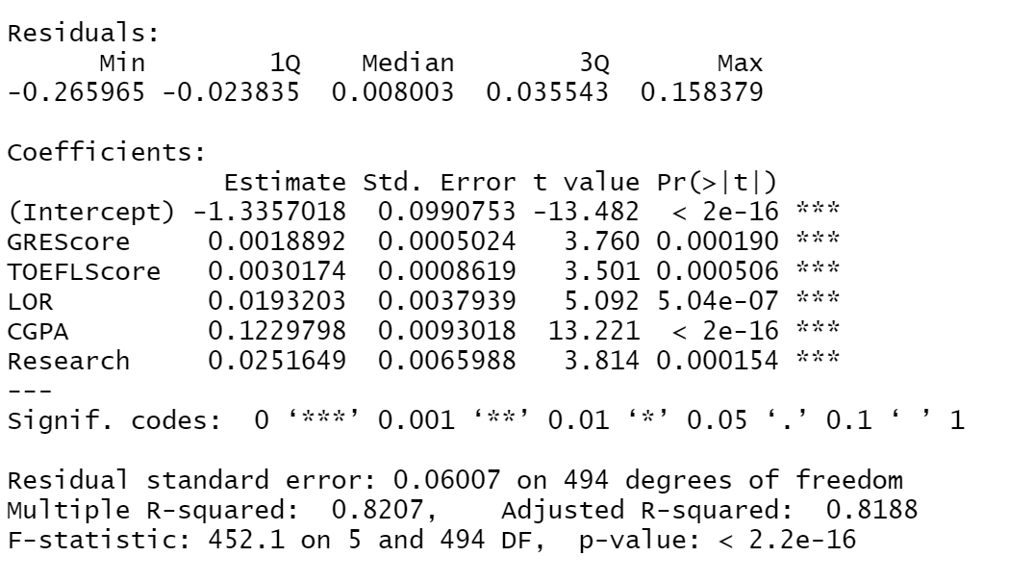
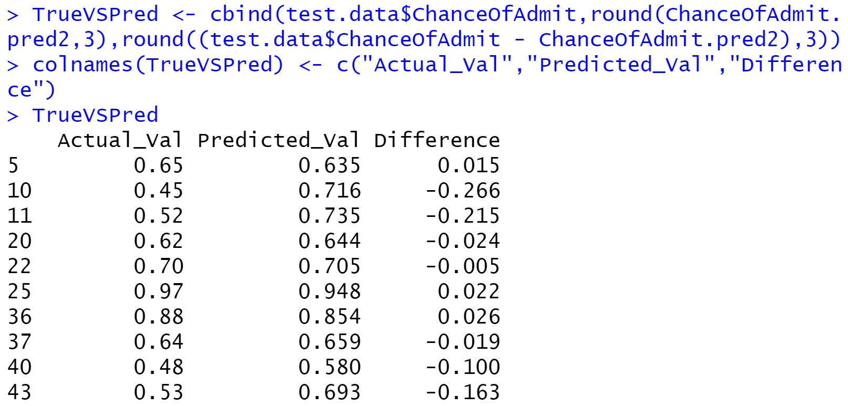
Conclusion
Final Model applied on complete data
Adjusted R-Square = 81.88%
Notes:
Overall, we decided that the continuous model 2 was a bit better than model 1, even though the rmse was slightly higher. However, the categorical models were out of the picture. This is because the pvalues of the independent values were extremely high.
After choosing model 2 we ran the model on all the data we have, and this was our output.
Nonetheless, the categorical models did make logical sense and perhaps they would be better. However, we would require more data.

